Slide 1

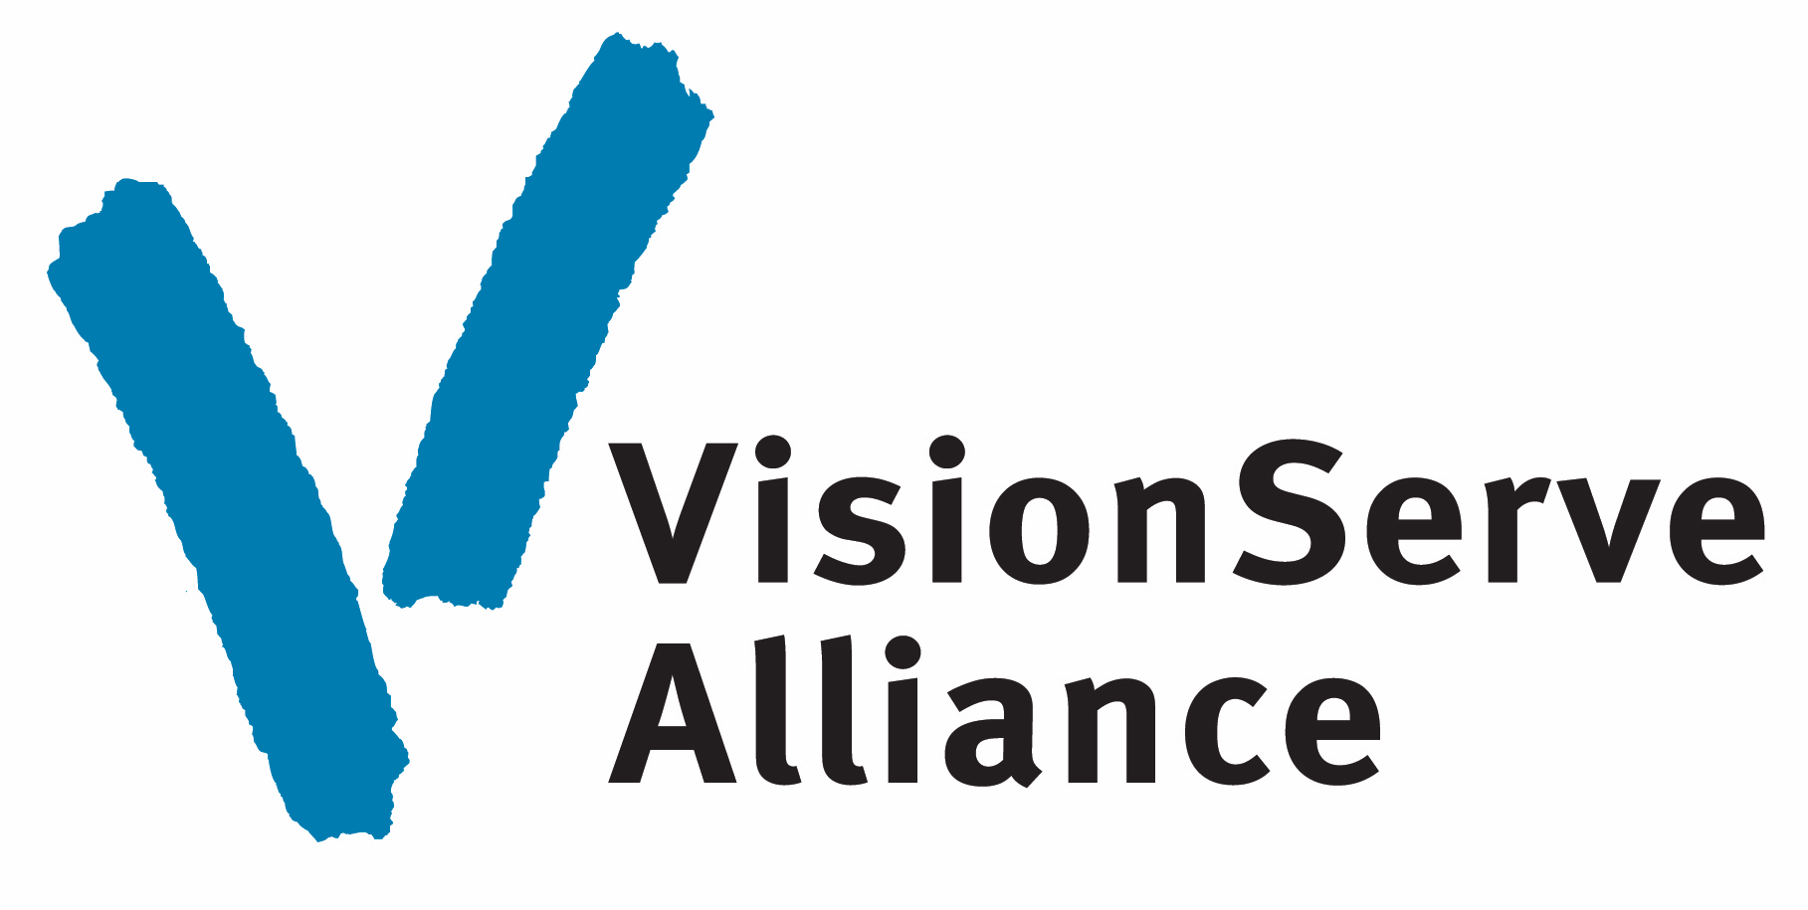
Member Exclusive
VisionServe Alliance Marketing & Public Awareness Benefits

Slide 2

2024 Marketing Benefits
Increase awareness of your organization, programs & services
Reach more people with information on the life-changing benefits of Vision Rehabilitation
Play a key role in industry-wide national Vision Rehabilitation
campaigns
Discover three new ways to extend your reach and impact!

Slide 3
Turnkey Implementation
Public Awareness
SEO & Grant Spend
Vision Rehabilitation Blog

Slide 4
Vision Rehabilitation Blog
Members can use the Blog to provide essential education and
increase public awareness of Vision Rehabilitation Services
Vital Education
Turnkey Implementation
Blog provides education on a broad range of Vision and Vision Rehabilitation Topics
Embed the blog on your website or link to our Vision Rehabilitation Blog micro-site
Public Awareness
SEO & Grant Spend
Expands public awareness about Vision Rehabilitation and related programs & services
Content provides keyword rich content to support Search Engine Optimization, Organic Search
& Google Ad Grants

Slide 5
Vision Rehabilitation Blog
Monthly blog covering timely and high-interest topics related to Vision Rehabilitation
  Can add an additional layer of education and depth to your digital outreach.
  We will provide a quarterly editorial calendar highlighting upcoming topics
  Participating member are encouraged to submit topics
Blogs will be written to be suitable for various audiences
  Including people living with blindness and vision loss, their families, caregivers, and the professionals who support them
Age-specific posts
  Highlight the availability and importance of Vision Rehabilitation at any age
We plan to deliver one to two monthly posts
  You choose what to post, based on what you know will resonate most with your audience

Slide 6

Google Ad Grant Management
Google Grants are the nonprofit version of Google Ads, which displays your ad to people searching on Google.
Most 501(c)(3) nonprofits are eligible for the Google Grant program. Typically, it takes 2-3 weeks for approval.
Once your nonprofit is approved to participate, you’ll receive $10,000 in Google Ads credit each month at no cost (up to $120,000 annually).
Grants can be used across a range of digital objectives, including:
  Grants can build awareness
  Promote a blog
  Drive website visits
  Attract new donors
  New email subscribers
  Support SEO, and more

Slide 7
Google Ad Grant Management
Blue Tusk can work closely with you and your team to use a Google Ad Word grant to maximize awareness. Services include:
  Consultation
  Keyword Research
    Maximize the value of your Google Grant by providing you with a thorough recommendation of relevant paid and organic keywords.
  Digital Campaign Ads
  Website Page Optimization
  Click Strategy
    Build an efficient pre- and post-click strategy alongside Google Analytics to guarantee your conversions are tracked down to the root keyword.
  Monthly Meetings
Members-Only Savings
  Blue Tusk will provide Google-certified grant management services at a Members-Only fee of $350 per month – a 30% reduction – with no long-term commitment

Slide 8
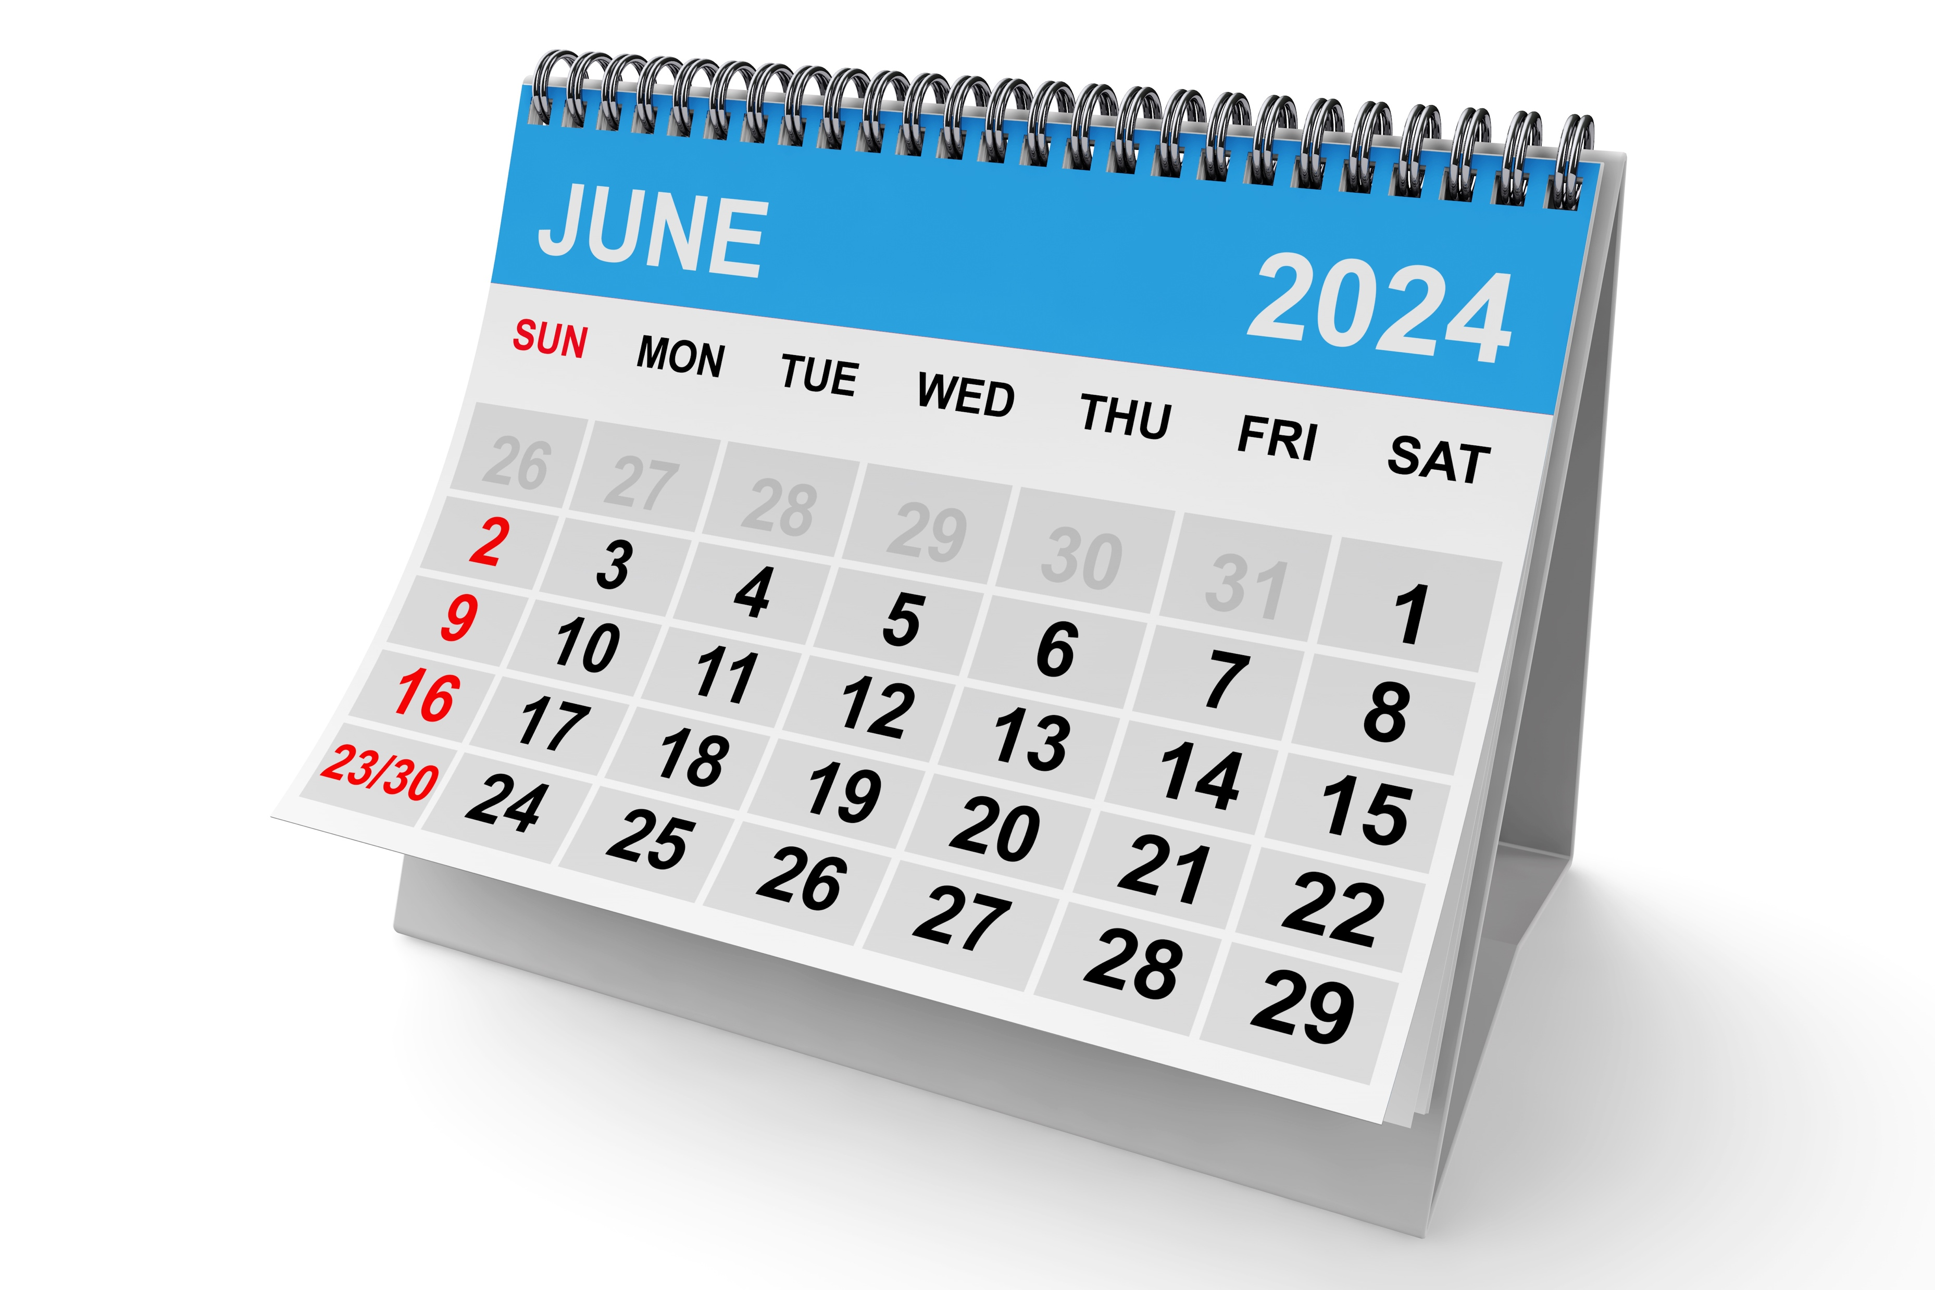
Vision Rehabilitation Week
Toolkit+ PR

Slide 9
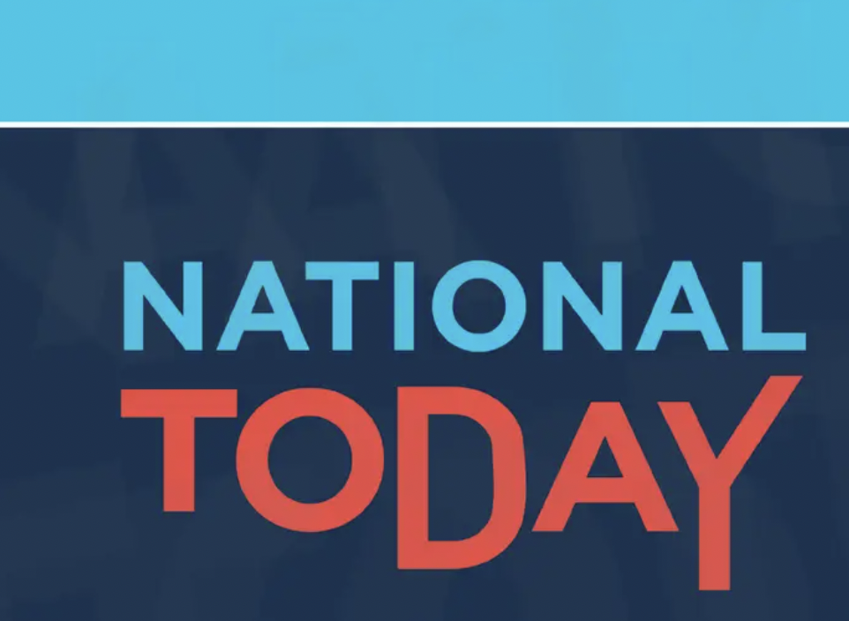
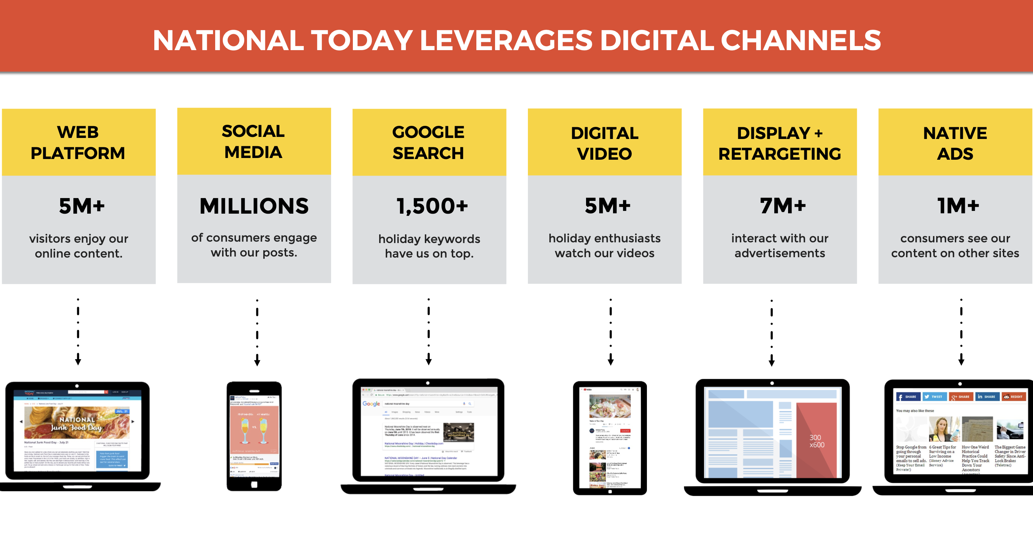
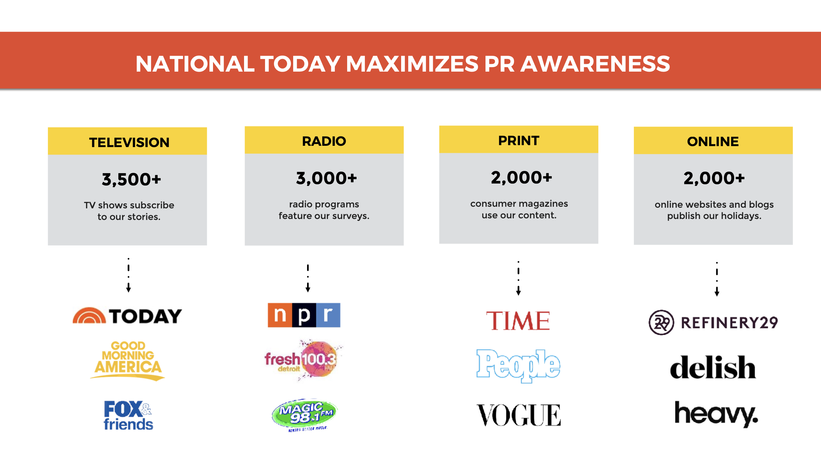
Vision Rehabilitation Week
Partnering with National Today
Recognized source - public and media discovery of cultural holidays
  Major brands establish their holidays, including IHOP, Major League Baseball, McDonald’s, Universal, Unilever, Williams Sonoma, and more
VRW Holiday page on NationalToday.com
New Holiday email sent to 350,000 National Today subscribers
National Today - a Trusted Source for Media Stories
  Thousands of media outlets - TV shows, radio shows consumer magazines, websites and blogs subscribe to National Today
Toolkit+ PR

Slide 10
Vision Rehabilitation Week
VisionServe Alliance
  Press release, holiday page on our website, Vision Rehabilitation Week solo emails, bi-monthly eNews, social media, google ads, and more.
National Partner Support
  National Council on Aging - Article + Social Media
  American Society on Aging - Article
  National Eye Institute
  Vision Health Advocacy Coalition (VHAC) feature
Pre-Holiday Features
  APH Blog
  FIDO Friendly magazine article + June social push 225,000+ followers
Toolkit+ PR

Slide 11
Vision Rehabilitation Week
Vision Rehabilitation Week Toolkit with content and graphics for your
  Websites, calendars, newsletters, social media, google ads, advertising, PR, and more
Calendar of other vision-themed holidays for the next 12-months, including White Cane Day, National Guide Dog Month, and others to help expand annual focus on vision rehabilitation and vital services provided by our field.
Toolkit+ PR

Slide 12
Holidays of Interest
January
Braille Literacy Month
Glaucoma Awareness Month
World Braille Day: January 4/Lewis Braille’s Birthday
February
AMD/Low Vision Month
March
Save Your Vision Month
Workplace Eye Awareness Month
World Optometry Day: March 23
April
CVI Literacy Awareness Month
Sports Eye Safety Month
Women's Eye Health and Safety Month
May
Healthy Vision Month
Blind Awareness Month
Vision Health Month
Global Accessibility Awareness Day (GAAD)
June
Vision Rehabilitation Week: June 10-16
Cataract Awareness Month
Helen Keller’s Birthday: June 27th
Deafblind Awareness Week / Helen Keller Deafblind Awareness Week
Nystagmus Awareness Day: June 20
July
Eye Injury Prevention Month
August
Children's Eye Health and Safety Month
Cataract Awareness Month
September
CVI Awareness
National Guide Dog Month
Falls Prevention (aging)
October
Vision Awareness Month
World Blindness Awareness Month
Meet the Blind Month
World Sight Day (second Thursday of October)
October 5: World Teachers' Day (UNESCO)
October 15: White Cane Day
October 15: Blind Americans Equality Day
National Braille Week
Home Eye Safety Month
National Disability Employment Awareness month
November
Diabetic Eye Disease Month
December
International Day of Persons with Disabilities: December 3

Slide 13

Q&A

